Slide 1
Credit Card Default Prediction System
-VIKRAM TAVITI

Slide 2
Objective:
The Credit card default prediction system is the binary classification model which helps us to predict the credit card defaulters based on the analysis of the data set from the client.

Slide 3
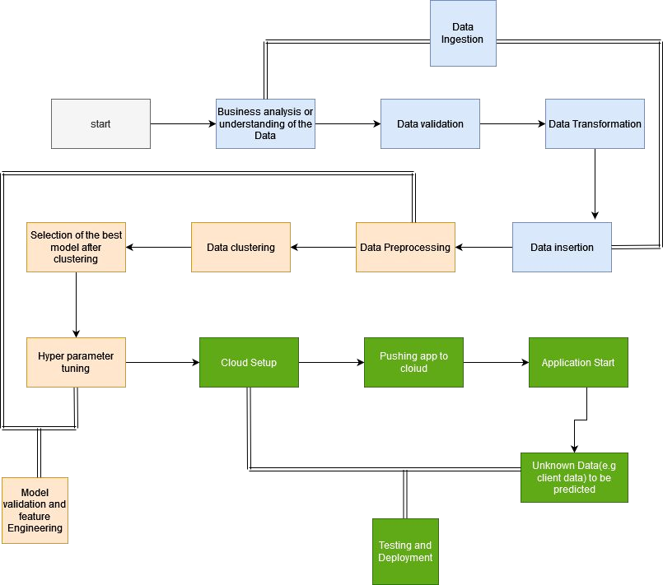
Architecture

Slide 4
Data Validation
In this step, we perform different sets of validation on the given dataset, 1 Name validation – Validating the data based on the pattern based.
After validating the data checking the length of the date in file as well as length of time in fil 2 Number of the columns – Validating the number of the columns in the file if the validation error occur the file will be not accepted.
3 The Datatype of the column – Validating the datatype of the column if there is no error then inserting the data into Database.
Data TransformationTaking the validating data and applying the data transformation process. Lets say if the data is in some categorical format or in any other language format then transforming the data into categorical transformation, date-time transformation, language transformation.

Slide 5
Data insertion
Database Creation and connection - Create a database with the given name .
If the database has already been created, open a connection to the database. The database will be in Cassandra.

Slide 6
Model Validation and feature engineering
Data Preprocessing
Check for null values in the columns. If present, impute the null values using the categorical imputer.
Scale the numeric values using the standard scaler.
Check for correlation.
Training the model
Various classification algorithms are used to build the model.
After testing and evaluation of the models, the best model is taken into consideration
Hyper parameter tuning is done to optimize the model.
API
A simple user-friendly web application is built using flask framework.
Deployment
The application is deployed on Heroku platform.

